Slide 1


Intrusion Detection System
Topic 7

Slide 2
Intrusion Detection System
Topic 7
LEARNING OUTCOME
At the end of this lesson, you will be able to :
Explain the differences between firewall V IDS V IPS.
Explain the differences between NIDS & HIDS.
Explain the differences between signature-based and anomaly-based intrusion detection.
Explain the differences between passive-based and active-based intrusion response.

Slide 3
Firewalls, IDS, IPS
Intrusion Detection System
Topic 7
DIFFERENCES
FIREWALL VS IDS VS IPS

Slide 4
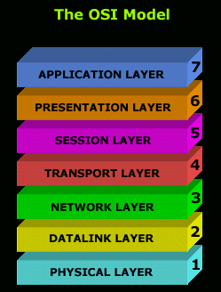


Firewalls, IDS, IPS
Intrusion Detection System
Topic 7
Application FW
N IDS / N IPS
Transmit
Receive
Stateless FW
Stateful FW
Send

Slide 5
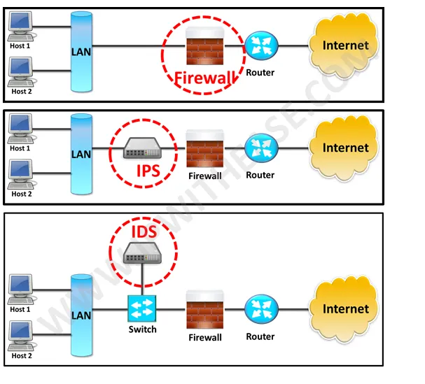
Firewalls, IDS, IPS
Intrusion Detection System
Topic 7
Each of these are just functions, not restricted to individual appliances

Slide 6


Firewalls, IDS, IPS
Intrusion Detection System
Topic 7
When a malicious attachment (e.g. word documents, excel spreadsheet, PDF, jpeg etc) is sent through the following functions, the behaviours are:
Firewall function → Ignore, because cannot inspect the inside of the attachment. No Deep Packet Inspection (DPI) capability.
N IDS function → Alert, because can inspect the inside of the attachment.
Has Deep Packet Inspection (DPI) capability.
N IPS function → Alert + Take Active Action, because can inspect the inside of the attachment. Has Deep Packet Inspection (DPI) capability.

Slide 7
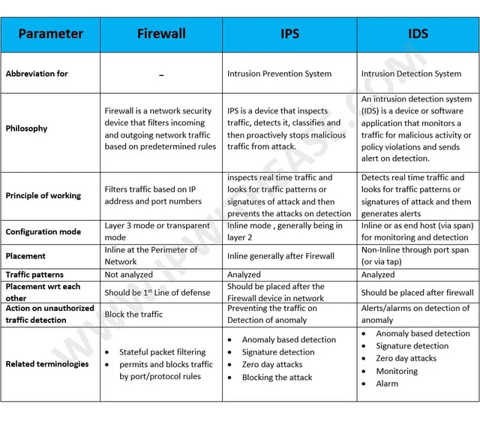
Firewalls, IDS, IPS
Intrusion Detection System
Topic 7

Slide 8
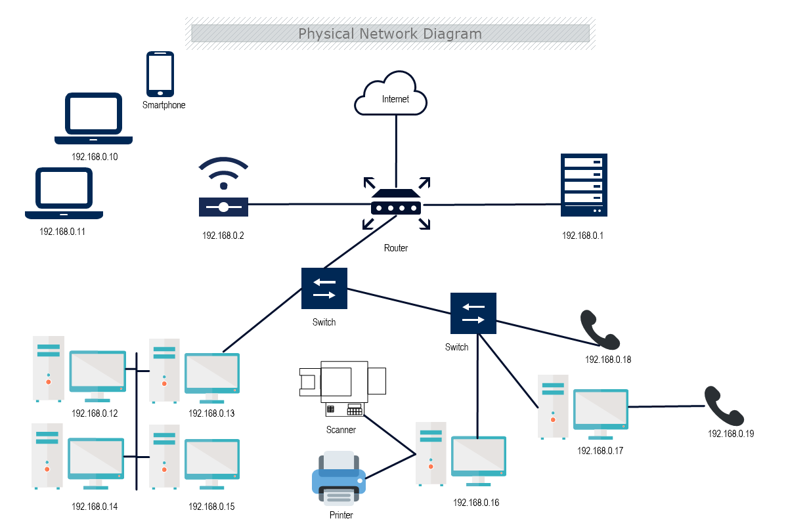
Firewalls, IDS, IPS
Intrusion Detection System
Topic 7
FW
H IDS
H IPS
FW
H IDS
H IPS
N IDS
Firewall
N IDS
N IPS
FW
H IDS
FW
H IDS
H IPS
H IPS
Firewall
N IPS
Span traffic
N IDS
FW
H IDS
FW
H IDS
H IPS
H IPS
FW
H IDS
H IPS
FW
H IDS
FW
H IDS
FW
H IDS
H IPS
H IPS
H IPS

Slide 9
NIDS and HIDS
Intrusion Detection System
Topic 7
DIFFERENCES
NIDS & HIDS
Course Slide 21, 35 - 56

Slide 10
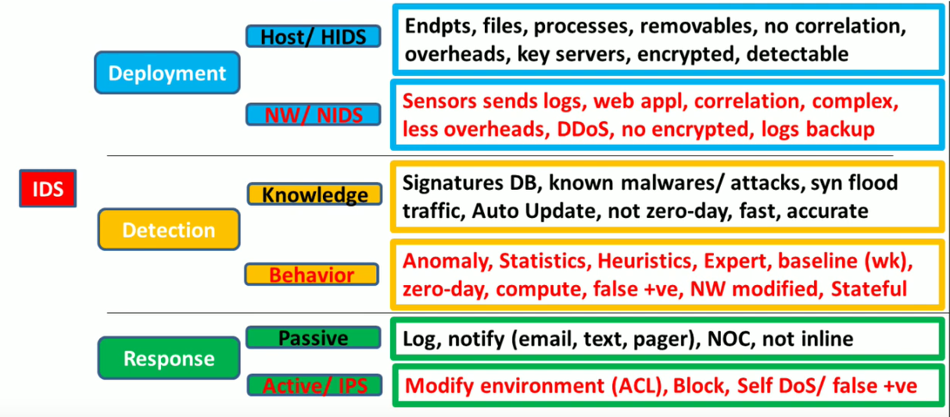
NIDS and HIDS
Intrusion Detection System
Topic 7

Slide 11
NIDS and HIDS
Intrusion Detection System
Topic 7
IDS| HIDS Vs NIDS
https://www.youtube.com/watch?v=YTWO7Q5iWzE

Slide 12
Signature and anomaly detections
Intrusion Detection System
Topic 7
DIFFERENCES
SIGNATURE-BASED & ANOMALY-BASED
DETECTIONS
Course Slide 14 – 20, 25

Slide 13
Steps in Intrusion Detection
Intrusion Detection System
Topic 7

Slide 14
Steps in Intrusion Detection
Intrusion Detection System
Topic 7
SIGNATURE based IDS Vs BEHAVIOR (Anomaly) based detection
https://www.youtube.com/watch?v=dvDcwHPoD9w

Slide 15
Signature and anomaly detections
Intrusion Detection System
Topic 7
DIFFERENCES
PASSIVE-BASED & ACTIVE-BASED
RESPONSES
Course Slide 24, 31, 42, 44

Slide 16
Steps in Intrusion Detection
Intrusion Detection System
Topic 7

Slide 17
Deployments
Intrusion Detection System
Topic 7
POSSIBLE
MODES OF DEPLOYMENTS
Course Slide 51 - 54

Slide 18
Deployments
Intrusion Detection System
Topic 7
FW
H IDS
E.g. Symantec
H IPS
E.g. Android FW
FW
H IDS
E.g.
Cisco
Palo Alto
WatchGuard
Zscaler
H IPS
E.g.
Symantec
N IDS
Firewall
N IDS
E.g. Symantec
N IPS
FW
H IDS
FW
H IDS
H IPS
H IPS
Firewall
N IPS
Span traffic
N IDS
E.g.
SolarWind
Snort
E.g.
Windows FW
FW
H IDS
FW
H IDS
H IPS
H IPS
E.g.
Tripwire
E.g.
Symantec
FW
H IDS
E.g.
Windows FW
E.g.
Symantec
H IPS
FW
H IDS
FW
H IDS
FW
H IDS
H IPS
H IPS
E.g.
Tripwire
H IPS

Slide 19
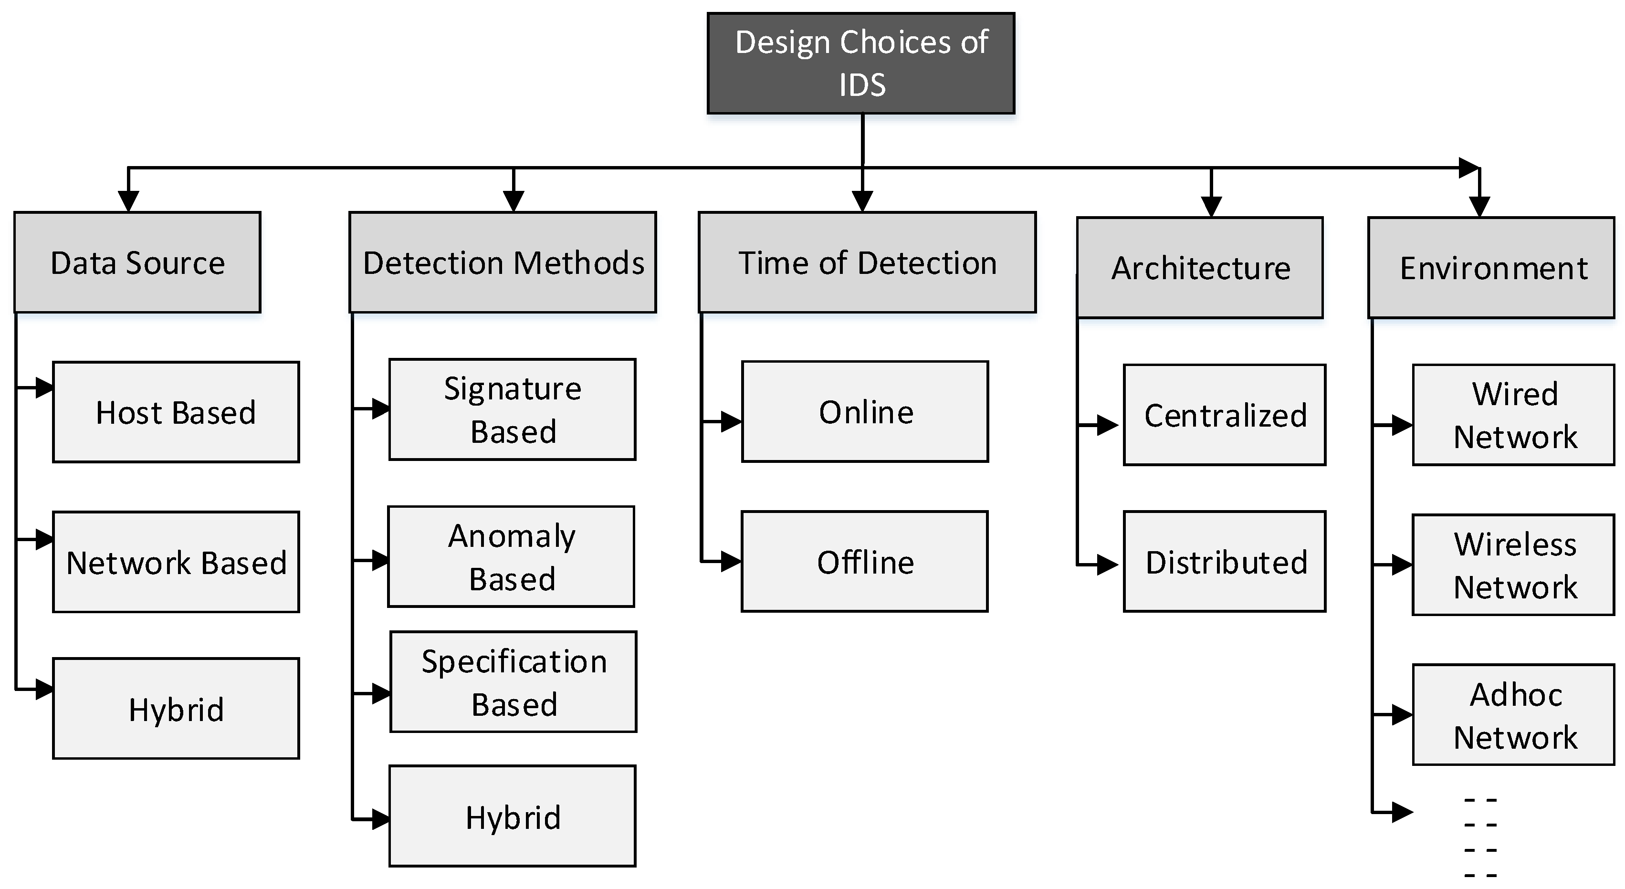
Deployments
Intrusion Detection System
Topic 7

Slide 20


